Slide 1
(GEO)SPATIAL INTERPOLATION USING POINT INFORMATION TO GENERATE SPATIAL SURFACES
Alejandro Ordonez
Assistant Professor - Department of Bioscience
Section for Ecoinformatics & Biodiversity
Center for Biodiversity Dynamics in a Changing World (BIOCHANGE)

Slide 2
What we will talk today
Spatial Interpolation basics
Using distances: Inverse distance weighting or Bilinear/Cubic interpolation
Using regressions: Linear regressions and locations as predictors
Using Splines: Splines and GAMS
Leveraging the Spatial knowledge
Building a variogram: The main ingredient of Geostatistical methods
Kriging: Univariate Geostatistical method
Co-kriging: Multivariate Geostatistical method

Slide 3
Any questions?
Ready to start?

Slide 4
Interpolation and Geostatistics
Typically, a limited number of sometimes arbitrarily chosen sample locations for which measurements/information on the random variable of intertest are available…
but you would like to know how the values of the variable across the study domain.
How can we “fill the gaps” between locations with information?
Notes:
rm(list=ls());gc()
library(gstat); library(maptools)
data(meuse)
coordinates(meuse) <- ~x+y
bubble(meuse,"zinc",main="Zinc concentration (ppm)")
data(meuse.grid)
coordinates(meuse.grid) <- ~x+y
idw.gstat <- gstat::idw(formula = zinc ~ 1, # formula as a intercept only
locations = meuse, # Points with the spatial and variable information
newdata = meuse.grid, # Area where the interpolation will take place
idp = 2.5) # inverse distance weighting power
spplot(idw.gstat,"var1.pred", colorkey = TRUE,main="Interpolated Zinc concentration (ppm)")

Slide 5
Non-geostatistical Interpolation Methods
Basic regression approaches can be used to “interpolate” the value of a variable of interest
Across the study spatial domain (usually done a regular grid).
Individual points/polygons defining locations or regions and located in a (i)regular pattern.
These are non-geostatistical “interpolation” approach based on
Distance as a predictors:
Inverse Distance Weighted Interpolation, Bilinear/cubic interpolation
A variable (locations) as a predictor:
Linear regression approaches, splines

Slide 6
Geostatistical VS nongeostatistical
Why are some interpolation methods non-geostatistical?
Method such Distance Weighted Interpolation, Bilinear/cubic interpolation are based on the idea that things that are close to one another are more alike than those that are farther apart.
Proximity defined importance of a known location to predict a ”new” point.
But you do not know how the degree of spatial dependence of a spatial random field (variable)
Defining a model that describes this dependency (aka the variogram) makes a method Geostatistical.

Slide 7
So far so good?
Any questions?
Ready to move on?

Slide 8
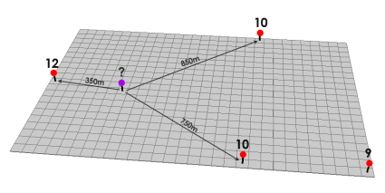
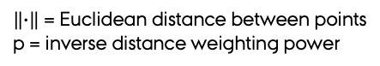
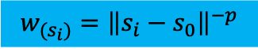
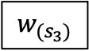
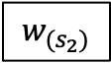
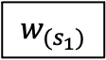
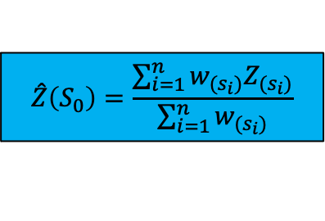
Inverse distance-based weighted interpolation (IDW)
Defines the degree to which nearest points are preferred to far points
Values are computed using a weighed average approach, where the “weights” are defined by the distance to the “interpolated” location.
It builds from the idea that near points are more alike than far points…
$$w_{(s_{i})}={\left\|s_{i}−s_{0}\right\|}^{−p}$$
$$w_{(s_{3})}$$
$$w_{(s_{1})}$$
$$w_{(s_{2})}$$
$$\hat{Z}\left(S_{0}\right)=\frac{\sum_{i=1}^{n}{w_{(s_{i})}Z_{(s_{i})}}}{\sum_{i=1}^{n}{w_{(s_{i})}}}$$
$\left\|∙\right\|$ = Euclidean distance between points
p = inverse distance weighting power

Slide 9
Inverse Distance Weighted Interpolation in R
Two different packages have an idw function:
idw function in spatstat
library(spatstat); library(maptools)
# create a A marked point pattern object
Meuse.ppp <- as.ppp.SpatialPointsDataFrame(meuse[,"zinc"]) # a maptools function
idw.spatstat <- spatstat::idw(X = Meuse.ppp, # A marked point pattern object
at = "pixel", # compute the intensity values
# at a grid of pixel locations
power = 2.5, # inverse distance weighting power
se=TRUE) # Estimate SE?
idw.spatstat[["estimate"]][["v"]][1:3,1:5]
[,1] [,2] [,3] [,4] [,5]
[1,] 578.3572 596.0304 615.2931 635.4013 655.0983
[2,] 587.7618 609.1425 633.1167 658.8865 684.8818
[3,] 592.5660 616.7551 644.4832 674.9176 706.1228
Notes:
rm(list=ls());gc()
library(spatstat); library(maptools)
data(meuse)
coordinates(meuse) <- ~x+y
# create a A marked point pattern object
Meuse.ppp <- as.ppp.SpatialPointsDataFrame(meuse[,"zinc"]) # a maptools function
idw.spatstat <- spatstat::idw(X = Meuse.ppp, # A marked point pattern object
at = "pixel", # compute the intensity values
# at a grid of pixel locations
power = 2.5, # inverse distance weighting power
se=TRUE) # Estimate SE?
idw.spatstat[["estimate"]][["v"]][1:3,1:5]

Slide 10
Inverse Distance Weighted Interpolation in R
Two different packages haver a idw function:
idw function in gstat
library(gstat)
idw.gstat <- idw(formula = zinc ~ 1, # formula as a intercept only
locations = meuse, # Points with the spatial and variable information
newdata = meuse.grid, # Area where the interpolation will take place
idp = 2.5) # inverse distance weighting power
as.data.frame(idw.gstat)[1:3, ]
x y var1.pred var1.var
1 181180 333740 701.9621 NA
2 181140 333700 799.9616 NA
3 181180 333700 723.5780 NA
Notes:
rm(list=ls());gc()
library(gstat)
data(meuse)
coordinates(meuse) <- ~x+y
data(meuse.grid)
coordinates(meuse.grid) <- ~x+y
idw.gstat <- gstat::idw(formula = zinc ~ 1, # formula as a intercept only
locations = meuse, # Points with the spatial and variable information
newdata = meuse.grid, # Area where the interpolation will take place
idp = 2.5) # inverse distance weighting power
as.data.frame(idw.gstat)[1:3, ]
detach("package:gstat", unload=TRUE)

Slide 11
Inverse Distance Weighted Interpolation in R
idw function in spatstat
plot(idw.spatstat)
idw function in gstat
spplot(idw.gstat,
colorkey = TRUE)
No error measurement
Notes:
rm(list=ls());gc()
library(spatstat); library(maptools)
data(meuse)
coordinates(meuse) <- ~x+y
# create a A marked point pattern object
Meuse.ppp <- as.ppp.SpatialPointsDataFrame(meuse[,"zinc"]) # a maptools function
idw.spatstat <- spatstat::idw(X = Meuse.ppp, # A marked point pattern object
at = "pixel", # compute the intensity values
# at a grid of pixel locations
power = 2.5, # inverse distance weighting power
se=TRUE) # Estimate SE?
plot(idw.spatstat)
detach("package:spatstat", unload=TRUE)
detach("package:maptools", unload=TRUE)
rm(list=ls());gc()
library(gstat)
data(meuse)
coordinates(meuse) <- ~x+y
data(meuse.grid)
coordinates(meuse.grid) <- ~x+y
idw.gstat <- gstat::idw(formula = zinc ~ 1, # formula as a intercept only
locations = meuse, # Points with the spatial and variable information
newdata = meuse.grid, # Area where the interpolation will take place
idp = 2.5) # inverse distance weighting power
spplot(idw.gstat, colorkey = TRUE)
detach("package:gstat", unload=TRUE)

Slide 12
Bilinear and cubic interpolation
Bilinear and cubic interpolation are techniques for calculating values of a location-based on nearby grid cells using distances as weights
Bilinear interpolation uses the 4 closest cell centers and takes a weighted average of these locations
Cubic interpolation uses the 16 closest cell centers and takes a weighted average of these locations.
Both approaches are implemented in the interp function of the akima package

Slide 13
Bilinear interpolation
$$f\left(x,y_{2}\right)≈\left[\left(\frac{x_{2}−x}{x_{2}−x_{1}}\right)∗f\left(Q_{1,2}\right)\right] +\left[\left(\frac{x−x_{1}}{x_{2}−x_{1}}\right)∗f\left(Q_{2,2}\right)\right]$$
F(Q_{1,2}) = (X₁,Y₂)
(X₂,Y₂) = F(Q_{2,2})
Step 1:
Linear interpolation in the X direction
(X,Y)
F(Q_{1,1}) = (X₁,Y₁)
(X₂,Y₁) = F(Q_{2,1})
$$f\left(x,y_{1}\right)≈\left[\left(\frac{x_{2}−x}{x_{2}−x_{1}}\right)∗f\left(Q_{1,1}\right)\right]+\left[\left(\frac{x−x_{1}}{x_{2}−x_{1}}\right)∗f\left(Q_{2,1}\right)\right]$$

Slide 14
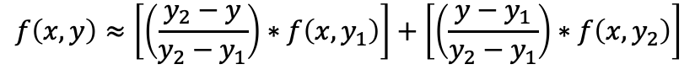
Bilinear interpolation
F(x,y₂)
Step 2:
linear interpolation of values generated in step 1 in the Y direction
F(Q_{1,2}) = (X₁,Y₂)
(X₂,Y₂) = F(Q_{2,2})
(X,Y)
$$f\left(x,y\right)≈\left[\left(\frac{y_{2}−y}{y_{2}−y_{1}}\right)∗f\left({x,y}_{1}\right)\right]+\left[\left(\frac{y−y_{1}}{y_{2}−y_{1}}\right)∗f\left({x,y}_{2}\right)\right]$$
F(Q_{1,1}) = (X₁,Y₁)
(X₂,Y₁) = F(Q_{2,1})
F(x,y₂)

Slide 15
Bilinear and cubic interpolation in R
Bilinear interpolation
Cubic interpolation
library(akima); library(sp)
data(meuse)
## Bilinear interpolation
MeuseZinc <- interp(x= meuse$x, # X-coordinates
y= meuse$y, # y-coordinates
z = meuse$zinc, # variable to interpolate
nx = 200, ny = 300,#dimension of output grid in x and y direction
linear = T) # indicating if linear (T) or cubic (F) interpolation should be
library(akima); library(sp)
data(meuse)
## Cubic interpolation
MeuseZinc <- interp(x= meuse$x, # X-coordinates
y= meuse$y, # y-coordinates
z = meuse$zinc, # variable to interpolate
nx = 200, ny = 300,#dimension of output grid in x and y direction
linear = F) # indicating if linear (T) or cubic (F) interpolation should be used.
Notes:
rm(list=ls());gc()
library(akima); library(sp)
data(meuse)
## Bilinear interpolation
MeuseZinc <- interp(x= meuse$x, # X-coordianates
y= meuse$y, # y-coordiates
z = meuse$zinc, # variable to interpolate
nx = 200, ny = 300,#dimension of output grid in x and y direction
linear = T, # indicating wether linear or cubic interpolation should be used.
extrap = F)
## cubic interpolation
MeuseZinc <- interp(x= meuse$x, # X-coordianates
y= meuse$y, # y-coordiates
z = meuse$zinc, # variable to interpolate
nx = 200, ny = 300,#dimension of output grid in x and y direction
linear = F, # indicating wether linear or cubic interpolation should be used.
extrap = F)
detach("package:sp", unload=TRUE)
detach("package:akima", unload=TRUE)

Slide 16
Bilinear and cubic interpolation in R
Bilinear interpolation
Cubic interpolation
Notes:
rm(list=ls());gc()
library(akima); library(sp)
data(meuse)
## Bilinear interpolation
MeuseZinc <- interp(x= meuse$x, # X-coordianates
y= meuse$y, # y-coordiates
z = meuse$zinc, # variable to interpolate
nx = 200, ny = 300,#dimension of output grid in x and y direction
linear = T, # indicating wether linear or cubic interpolation should be used.
extrap = F)
str(MeuseZinc)
# turn the list output to a xyz data.frame
MeuseZincDatFrm <- interp2xyz(MeuseZinc,
data.frame = T)
coordinates(MeuseZincDatFrm) <- ~x+y
gridded(MeuseZincDatFrm) <- TRUE
dev.new()
spplot(MeuseZincDatFrm,main="Bilinear interpolation")
## cubic interpolation
MeuseZinc <- interp(x= meuse$x, # X-coordianates
y= meuse$y, # y-coordiates
z = meuse$zinc, # variable to interpolate
nx = 200, ny = 300,#dimension of output grid in x and y direction
linear = F, # indicating wether linear or cubic interpolation should be used.
extrap = F)
# turn the list output to a xyz data.frame
MeuseZincDatFrm <- interp2xyz(MeuseZinc,
data.frame = T)
coordinates(MeuseZincDatFrm) <- ~x+y
gridded(MeuseZincDatFrm) <- TRUE
dev.new()
spplot(MeuseZincDatFrm,main="cubic interpolation")
detach("package:sp", unload=TRUE)
detach("package:akima", unload=TRUE)

Slide 17
Bilinear and cubic interpolation in R
Bilinear interpolation
Cubic interpolation
The white areas, are the regions outside the convex hull defined by the observations
The difference in shape of convex hulls relates to the difference in “used points
Notes:
rm(list=ls());gc()
library(akima); library(sp)
data(meuse)
## Bilinear interpolation
MeuseZinc <- interp(x= meuse$x, # X-coordianates
y= meuse$y, # y-coordiates
z = meuse$zinc, # variable to interpolate
nx = 200, ny = 300,#dimension of output grid in x and y direction
linear = T, # indicating wether linear or cubic interpolation should be used.
extrap = F)
str(MeuseZinc)
# turn the list output to a xyz data.frame
MeuseZincDatFrm <- interp2xyz(MeuseZinc,
data.frame = T)
coordinates(MeuseZincDatFrm) <- ~x+y
gridded(MeuseZincDatFrm) <- TRUE
dev.new()
spplot(MeuseZincDatFrm,main="Bilinear interpolation")
## cubic interpolation
MeuseZinc <- interp(x= meuse$x, # X-coordianates
y= meuse$y, # y-coordiates
z = meuse$zinc, # variable to interpolate
nx = 200, ny = 300,#dimension of output grid in x and y direction
linear = F, # indicating wether linear or cubic interpolation should be used.
extrap = F)
# turn the list output to a xyz data.frame
MeuseZincDatFrm <- interp2xyz(MeuseZinc,
data.frame = T)
coordinates(MeuseZincDatFrm) <- ~x+y
gridded(MeuseZincDatFrm) <- TRUE
dev.new()
spplot(MeuseZincDatFrm,main="cubic interpolation")
detach("package:sp", unload=TRUE)
detach("package:akima", unload=TRUE)

Slide 18
So far so good?
Any questions?
Ready to move on?

Slide 19
Splines as an Interpolation models
All approaches are based on the idea of 2-dimensional smoothing splines.
As IDW and bilinear/cubic interpolation, these methods are not “geostatistical” in the sense that there is no model of the spatial structure of the data.
The only goal here is to generate a “smooth” surface.
I will present two options
Thin-plate splines: the smoothing, is based on the rigidity of the “surface”.
GAMs: Generalised Additive Model where you generate a “smoothing” function that optimized the fit to the used data.

Slide 20
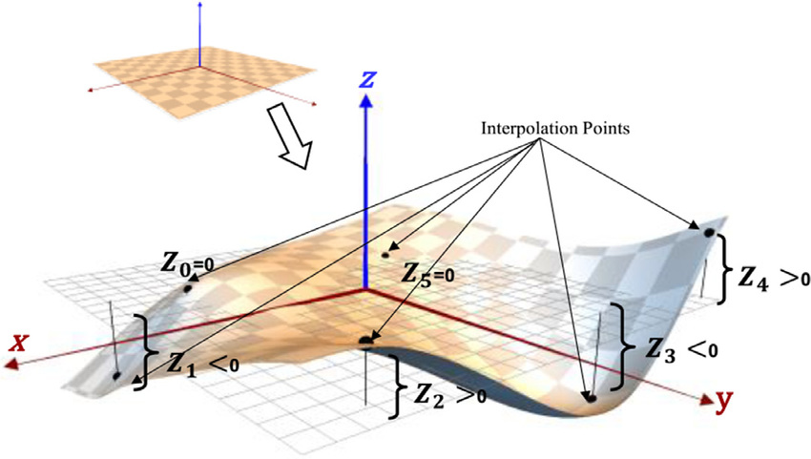
Thin-plate splines (TPS) in R
A good analogy for the method is a a thin (so, flexible) plate that is warped to fit the data.
This “surface” can be:
Very “rigid”, i.e., just a single surface (the usual least-squares).
Very “flexible”, (i.e., perfectly fitting every observation).

Slide 21
Thin-plate splines (TPS)
This is a 2-dimensional smoothing spline focused on minimize the residual sum of squares (RSS) of the fitted function → a surface in between rigid and flexible.
This rigidity is defined as a roughness penalty: balance between the fit to the observations and smoothness of the function.
TPS balance between the smoothness and the penalty is defined using a cross-validation approach.

Slide 22
Thin-plate splines (TPS)
The function to implement a TPS interpolation is Tps and is part of the fields package (which also includes functions for kriging, sampling design, and visualization)
BTW, The fields package does not use Spatial* classes or data.frames
It requires two arguments
A vector of dependent variables
A matrix of coordinates (rows are observation locations, columns are the two coordinates)
Both of these can be directly extracted form any Spatial* Object

Slide 23
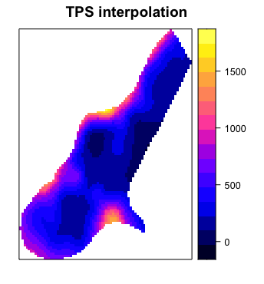
Thin-plate splines (TPS) in R
require(fields)
data(meuse)
## Build a thin plate spline model
surf.1 <-Tps(x = meuse[,c("x","y")],#Matrix of independent variables (locations)
Y = meuse$zinc, # Vector of dependent variables
lon.lat = T) # interpreted as longitude and latitude
Notes:
rm(list=ls());gc()
require(fields)
data(jura)
jura.pred.SpPnt <- jura.pred
coordinates(jura.pred.SpPnt) <- ~ long + lat
spplot(jura.pred.SpPnt,"Co", colorkey = TRUE,
main="Cobalt In Sampled sites in the Swiss Jura Mountains")
jura.pred$coords <- matrix(c(jura.pred$Xloc, jura.pred$Yloc), byrow=F, ncol=2)
str(jura.pred)
# thin plate spline surface to irregularly spaced data
## A MATRIX OF LOCATIONS
LocMatirx <- jura.pred[,c("long","lat")]
## A VECTOR OF PREDICTORS
PredVct <- jura.pred$Co
## Buind a thin plate spline model
surf.1 <-Tps(x = LocMatirx,#Matrix of independent variables (locations)
y = PredVct, # Vector of dependent variables
lon.lat = T) # interpreted as lognitude and latitude
## Estimate the thin plate spline sourface
surf.1.pred <- predict.Krig(surf.1,
matrix(c(jura.grid$long, jura.grid$lat),
byrow=F, ncol=2))
jura.SpaGrid <- jura.grid
jura.SpaGrid$TpsPred <- surf.1.pred
coordinates(jura.SpaGrid) <- ~long + lat
gridded(jura.SpaGrid) <- TRUE
spplot(jura.SpaGrid,"TpsPred", colorkey = TRUE,
main="Predicted Cobalt In Sampled sites in the Swiss Jura Mountains")

Slide 24
Thin-plate splines (TPS) in R
# thin plate spline surface to irregularly spaced data
## A MATRIX OF LOCATIONS
LocMatirx <- jura.pred[,c("long","lat")]
## A VECTOR OF PREDICTORS
PredVct <- jura.pred$Co
## Build a thin plate spline model
surf.1 <-Tps(x = LocMatirx,#Matrix of independent variables (locations)
y = PredVct, # Vector of dependent variables
lon.lat = T) # interpreted as longitude and latitude
## Estimate the thin plate spline surface
## A MATRIX OF LOCATIONS
LocMatirx <- jura.grid[,c("long","lat")]
surf.1.pred <- predict.Krig(surf.1,
LocMatirx)
The Tps function build a model
The model is then predicted on a matrix of locations

Slide 25
Thin-plate splines (TPS) in R
> summary(surf.1)
CALL:
Tps(x = LocMatirx, Y = PredVct, lon.lat = T)
Number of Observations: 259
Number of unique points: 259
Number of parameters in the null space 3
Parameters for fixed spatial drift 3
Effective degrees of freedom: 155.7
Residual degrees of freedom: 103.3
MLE sigma 0.9135
GCV sigma 1.097
MLE rho 14.17
Scale passed for covariance (rho) <NA>
Scale passed for nugget (sigma^2) <NA>
Smoothing parameter lambda 0.0589
Residual Summary:
min 1st Q median 3rd Q max
-3.179000 -0.269100 -0.006827 0.202400 2.905000
...
The smoothing parameter is perhaps the most important value in this output.
Optimized using
generalized cross-validation (GCV)
(But can be passed as an argument)

Slide 26
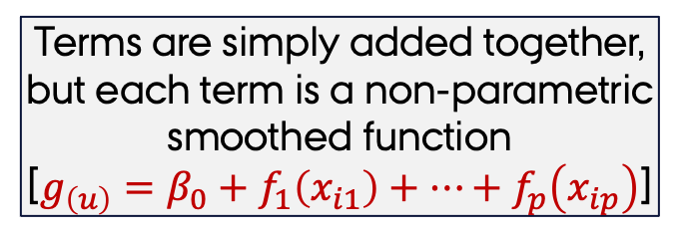
Generalised Additive Models (GAMs)
Terms are simply added together, but each term is a non-parametric smoothed function
[$g_{\left(u\right)}=β_{0}+f_{1}\left(x_{i1}\right)+…+f_{p}\left(x_{ip}\right)$]
Can handle many distributions of the response variable
[normal, binomial, counts]
This is a statistical model
Generalised Additive Models

Slide 27
Generalised Additive Models The two packages
Using gam
Degree of the polynomial repression
-1 = linear
Proportion of the observations in the window
gam(Y.Var ∼ lo(Xvar, degree=-1, span = 0.5))
Using mgcv
gam(Y.Var∼s(Xvar, fx=F, k=-1, bs="cr"))
Spline type
fixed (T) penalized (F)
Basis function
Spline family
cr=cubic
tp=thin-plate
This default finds the optimal amount of smoothing

Slide 28
Generalised Additive Models for two dimensional data
Two approaches:
Use data measured across the region (just as in a regression approach).
Use the positional data (Lat/long or Y/X) as predictors.
Multiple model specifications depending on the predictors:
Add each variable individually → as in a regression.
Use smoothing functions (tensor product smooths) that represent interactions between variables.

Slide 29
Generalised Additive Models With a predictor
## fit model using dist as predictor
surf.1 <- gam(log(zinc) ~s(dist),data= meuse)
## Predict the model
fit1 <- predict.gam(surf.1 ,
newdata = meuse.grid)
## Make the predictions a Spatial* Object
meuse.grid $fit1 <- fit1
meuse.SpaGrid <- meuse.grid
coordinates(meuse.SpaGrid) <- ~x + y
spplot(meuse.SpaGrid,"fit1", colorkey = TRUE,
main="GAM Predicted Zinc")
Notes:
rm(list=ls());gc()
require(fields)
require(mgcv)
require(gstat)
data(meuse)
data(meuse.grid)
surf.1 <- gam(log(zinc) ~s(dist),data= meuse) ## fit model
fit1 <- predict.gam(surf.1 ,
newdata = meuse.grid)
meuse.grid $fit1 <- fit1
meuse.SpaGrid <- meuse.grid
coordinates(meuse.SpaGrid) <- ~x + y
dev.new()
spplot(meuse.SpaGrid,"fit1", colorkey = TRUE,
main="GAM Predicted Zinc\nbased on distance")

Slide 30
Generalised Additive Models in two dimensions
## fit model using spatial locations as predictors
surf.1 <- gam(log(zinc) ~s(x)+s(y),data= meuse)
## Predict the model
fit1 <- predict.gam(surf.1 ,
newdata = meuse.grid)
## Make the predictions a Spatial* Object
meuse.grid $fit1 <- fit1
meuse.SpaGrid <- meuse.grid
coordinates(meuse.SpaGrid) <- ~x + y
spplot(meuse.SpaGrid,"fit1", colorkey = TRUE,
main="GAM Predicted Zinc\nbased on Locatios")
Notes:
rm(list=ls());gc()
require(fields)
require(mgcv)
require(gstat)
data(meuse)
data(meuse.grid)
## fit model
surf.1 <- gam(log(zinc) ~s(x)+s(y),data= meuse)
## Predict the model
fit1 <- predict.gam(surf.1 ,
newdata = meuse.grid)
## Make the predictions a Spatial* Object
meuse.grid $fit1 <- fit1
meuse.SpaGrid <- meuse.grid
coordinates(meuse.SpaGrid) <- ~x + y
dev.new()
spplot(meuse.SpaGrid,"fit1", colorkey = TRUE,
main="GAM Predicted Zinc\nbased on Locatios")

Slide 31
Generalised Additive Models in two dimensions
## fit model using Interacting Locations.
surf.1 <- gam(log(zinc) ~s(x,y),data= meuse)
## Predict the model
fit1 <- predict.gam(surf.1 ,
newdata = meuse.grid)
## Make the predictions a Spatial* Object
meuse.grid $fit1 <- fit1
meuse.SpaGrid <- meuse.grid
coordinates(meuse.SpaGrid) <- ~x + y
spplot(meuse.SpaGrid,"fit1", colorkey = TRUE,
main="GAM Predicted Zinc\nbased on Interacting Locations")
Why you can use a two dimensional smoothing and not tensor product smooths
Notes:
rm(list=ls());gc()
require(fields)
require(mgcv)
require(gstat)
data(meuse)
data(meuse.grid)
## fit model
surf.1 <- gam(log(zinc) ~s(x,y),data= meuse)
## Predict the model
fit1 <- predict.gam(surf.1 ,
newdata = meuse.grid)
## Make the predictions a Spatial* Object
meuse.grid $fit1 <- fit1
meuse.SpaGrid <- meuse.grid
coordinates(meuse.SpaGrid) <- ~x + y
dev.new()
spplot(meuse.SpaGrid,"fit1", colorkey = TRUE,
main="GAM Predicted Zinc\nbased on Interacting Locatios")

Slide 32
So far so good?
Any questions?
Ready to move on?

Slide 33
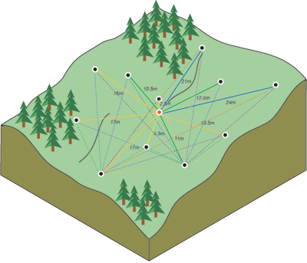
What is regression Kriging?
A technique to predict the value of a function at a given point by combining
A regression of the dependent variable on auxiliary variables
Kriging of the regression residuals.
Kriging uses the variogram to compute a weighted average of the known values of the function in the neighborhood of the point.

Slide 34
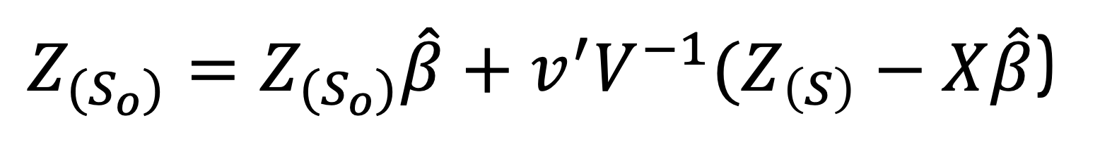
Kriging Basics
Kriging approaches are build on the principle that the (semi)variogram can be used to define a series of weights to the residuals.
The (semi)variogram defines a distance decay function to specify how important are nearby points for a prediction, and the overall spatial arrangement of the measured points.
$Z_{(S_{o})}=Z_{(S_{o})}\hat{β}+v^{′}V^{−1}(Z_{\left(S\right)}−X\hat{β}$)
Regression
Kriging
Weights
Residuals

Slide 35
Universal, Ordinary, and Simple Kriging
Universal Kriging
A series of covariates are used as predictors
krige(log(zinc) ~ sqrt(dist),
data = meuse,
newdata = meuse.grid,
model = vt.fit)
Ordinary Kriging
An intercept only model
No Covariates are defined
krige(log(zinc) ~ 1,
data = meuse,
newdata = meuse.grid,
model = vt.fit)
Simple Kriging
An intercept only model
The intercept is defined
krige(log(zinc) ~ 1,
data = meuse,
newdata = meuse.grid,
model = vt.fit,
beta = 5.9)
Notes:
rm(list=ls());gc()
require(gstat)
require(sp)
data(meuse)
coordinates(meuse) <- ~x + y
data(meuse.grid)
coordinates(meuse.grid) <- ~x + y
# Universal Kriging
v <- variogram(log(zinc) ~ sqrt(dist) , meuse)
v.fit <-fit.variogram(v,
vgm(1, "Sph", 800, 1))
v.fit
meuse.krige <- krige(log(zinc) ~ sqrt(dist) ,
locations = meuse,
newdata =meuse.grid,
model = v.fit)
# Ordinary Kriging
v <- variogram(log(zinc) ~ 1, meuse)
v.fit <-fit.variogram(v,
vgm(1, "Sph", 800, 1))
v.fit
meuse.krige <- krige(log(zinc) ~ 1,
locations = meuse,
newdata =meuse.grid,
model = v.fit)
# Simple Kriging
v <- variogram(log(zinc) ~ 1, meuse)
v.fit <-fit.variogram(v,
vgm(1, "Sph", 800, 1))
v.fit
meuse.krige <- krige(log(zinc) ~ 1,
locations = meuse,
newdata =meuse.grid,
model = v.fit,
beta = 5.9 )

Slide 36
Universal, Ordinary, and Simple Kriging
Universal Kriging
Ordinary Kriging
Simple Kriging
Notes:
rm(list=ls());gc()
require(gstat)
require(sp)
data(meuse)
coordinates(meuse) <- ~x + y
data(meuse.grid)
coordinates(meuse.grid) <- ~x + y
# Universal Kriging
v <- variogram(log(zinc) ~ sqrt(dist) , meuse)
v.fit <-fit.variogram(v,
vgm(1, "Sph", 800, 1))
v.fit
meuse.krige <- krige(log(zinc) ~ sqrt(dist) ,
locations = meuse,
newdata =meuse.grid,
model = v.fit)
spplot(meuse.krige, c("var1.pred"), colorkey = TRUE,
main="Universal Kriging")
# Ordinary Kriging
v <- variogram(log(zinc) ~ 1, meuse)
v.fit <-fit.variogram(v,
vgm(1, "Sph", 800, 1))
v.fit
meuse.krige <- krige(log(zinc) ~ 1,
locations = meuse,
newdata =meuse.grid,
model = v.fit)
spplot(meuse.krige, c("var1.pred"), colorkey = TRUE,
main="Ordinary Kriging")
# Simple Kriging
v <- variogram(log(zinc) ~ 1, meuse)
v.fit <-fit.variogram(v,
vgm(1, "Sph", 800, 1))
v.fit
meuse.krige <- krige(log(zinc) ~ 1,
locations = meuse,
newdata =meuse.grid,
model = v.fit,
beta = 5.9 )
spplot(meuse.krige, c("var1.pred"), colorkey = TRUE,
main="Simple Kriging")

Slide 37
Universal, Ordinary, and Simple Kriging Differences
Universal Kriging
Ordinary Kriging
Simple Kriging

Slide 38
So far so good?
Any questions?
Ready to move on?

Slide 39
Spatial Correlation: The Variogram
In geo-statistics the spatial correlation is modelled via the variogram
NOT the correlogram → correlogram focus on a ONE dimensional space
(One variable at a time)
To estimate the partial correlation (i.e., the variogram) from observational data we assume stationarity and isotropy.
Stationarity
The relation between observations DOES NOT depend on their location but DOES depend on the distance between them.
Isotropy
The relation between observations DOES NOT depend on the direction between two points

Slide 40
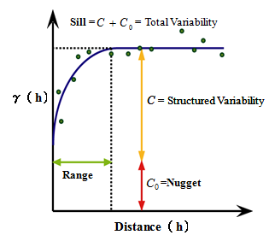
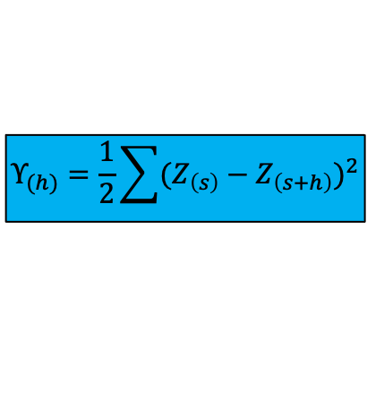
Spatial Correlation: The Variogram
By assuming stationarity and isotropy the variogram can be estimated by establishing the relation between differences in the observations and distance between observations.
$$Υ_{(h)}=\frac{1}{2}\sum{{(Z_{\left(s\right)}−Z_{\left(s+h\right)})}^{2}}$$

Slide 41
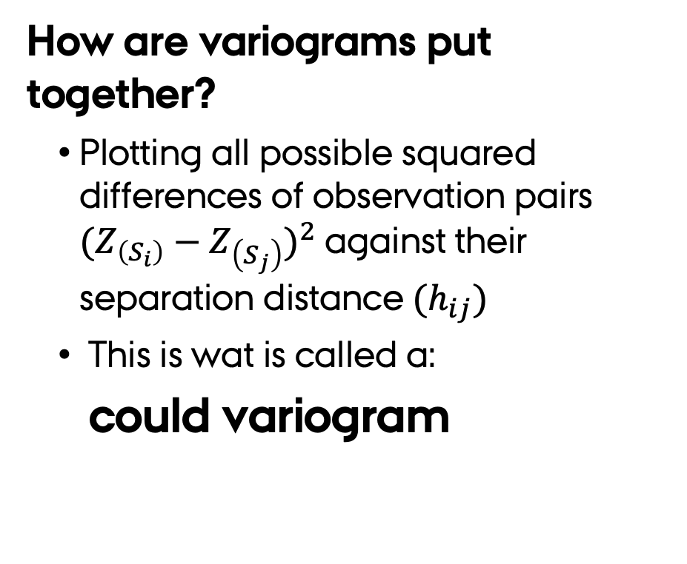
Spatial Correlation: The Variogram
How are variograms put together?
Plotting all possible squared differences of observation pairs ${(Z_{\left(S_{i}\right)}−Z_{\left(S_{j}\right)})}^{2}$against their separation distance$(h_{ij})$
This is wat is called a:
could variogram
Variogram.Zn <- variogram(log(zinc) ~ 1,
data = meuse,
# calculate the semivariogram cloud
cloud = TRUE)
plot(Variogram.Zn,
main="Could variogram",cex.main=2)
Notes:
rm(list=ls());gc()
require(sp)
require(gstat)
data(meuse)
coordinates(meuse) <- ~x + y
plot(y = dist(log(meuse$zinc))^2,
x = dist(coordinates(meuse)),
pch = 19,cex=0.5,
col="lightblue",
xlab="Distance", ylab="gamma",
main="could variogram",cex.main=2)

Slide 42
Spatial Correlation: The Variogram
How are variograms put together?
Plotting all possible squared differences of observation pairs ${(Z_{\left(S_{i}\right)}−Z_{\left(S_{j}\right)})}^{2}$against their separation distance$(h_{ij})$
This is wat is called a:
could variogram
Notes:
rm(list=ls());gc()
require(sp)
require(gstat)
data(meuse)
coordinates(meuse) <- ~x + y
plot(y = dist(log(meuse$zinc))^2,
x = dist(coordinates(meuse)),
pch = 19,cex=0.5,
col="lightblue",
xlab="Distance", ylab="gamma",
main="could variogram",cex.main=2)

Slide 43
Spatial Correlation: The Variogram
The semivaraince in the variogram cloud can be “averaged” over a given distance intervals (h) to generate the
sample variogram
Doing this “smooths” the variation in the could variogram and provides a signal of the “full” variogram
Variogram.Zn <- variogram(log(zinc) ~ 1,
data = meuse)
plot(Variogram.Zn,
## add the number of point pairs per dist class
plot.numbers = TRUE,
pch = "+",
main="Sample variogram")
The value next to each mark is the number of point-pairs within the distance bin
Notes:
rm(list=ls());gc()
require(sp)
require(gstat)
data(meuse)
coordinates(meuse) <- ~x + y
Variogram.Zn <- variogram(log(zinc) ~ 1,
data = meuse)
plot(Variogram.Zn,
## add the number of point pairs for this estimate
plot.numbers = TRUE,
pch = "+",
main="Sample variogram")

Slide 44
Spatial Correlation: The Variogram
The semivaraince in the variogram cloud can be “averaged” over a given distance intervals (h) to generate the
sample variogram
Doing this “smooths” the variation in the could variogram and provides a signal of the “full” variogram
The value next to each mark is the number of point-pairs within the distance bin
Notes:
rm(list=ls());gc()
require(sp)
require(gstat)
data(meuse)
coordinates(meuse) <- ~x + y
Variogram.Zn <- variogram(log(zinc) ~ 1,
data = meuse)
plot(Variogram.Zn,
## add the number of point pairs for this estimate
plot.numbers = TRUE,
pch = "+",
main="Sample variogram")

Slide 45
Spatial Correlation: The Variogram
The default implementation of the sample variogram done by the variogram function uses by default:
1st – A predefined cut-off distance:
The maximum distance up to which point pairs are considered is one third of the largest diagonal of the bounding box.
Why?: autocorrelations are never computed for lags farther than half the series length → makes no sense to compute semi-variances for long distances
You would usually want to reduce the cut-off distance – think local predictions.

Slide 46
Spatial Correlation: The Variogram
cutoff=500
default
cutoff=3000
Notes:
rm(list=ls());gc()
require(sp)
require(gstat)
data(meuse)
coordinates(meuse) <- ~x + y
Variogram.Zn <- variogram(log(zinc) ~ 1,
data = meuse,
cutoff=500)
plot(Variogram.Zn,
## add the number of point pairs for this estimate
plot.numbers = TRUE,
pch = "+",
main="Sample variogram\n cutoff=500")
Variogram.Zn <- variogram(log(zinc) ~ 1,
data = meuse)
plot(Variogram.Zn,
## add the number of point pairs for this estimate
plot.numbers = TRUE,
pch = "+",
main="Sample variogram\n default")
Variogram.Zn <- variogram(log(zinc) ~ 1,
data = meuse,
cutoff=3000)
plot(Variogram.Zn,
## add the number of point pairs for this estimate
plot.numbers = TRUE,
pch = "+",
main="Sample variogram\n cutoff= 3000")

Slide 47
Spatial Correlation: The Variogram
The default definition of the sample variogram done by the variogram function makes some decisions for you:
2nd – The distance interval width:
The distance interval over which the semivariances are averaged is is the cut-off value divided by 15 (to generate 15 points)
Choosing a smaller interval width will result in more detail
→ but can enhance noise.
You can specify the intervals in two ways:
Define the width argument: size of distance intervals
Define the boundaries argument: each interval to be plotted

Slide 48
Spatial Correlation: The Variogram
width = 50
width
default
boundaries
boundaries = c(seq(0, 100, 20),
seq(250, 1500, 200)
Notes:
rm(list=ls());gc()
require(sp)
require(gstat)
data(meuse)
coordinates(meuse) <- ~x + y
Variogram.Zn <- variogram(log(zinc) ~ 1,
data = meuse,
width=50)
plot(Variogram.Zn,
## add the number of point pairs for this estimate
plot.numbers = TRUE,
pch = "+",
main="Sample variogram\n width=50")
Variogram.Zn <- variogram(log(zinc) ~ 1,
data = meuse)
plot(Variogram.Zn,
## add the number of point pairs for this estimate
plot.numbers = TRUE,
pch = "+",
main="Sample variogram\n default")
Variogram.Zn <- variogram(log(zinc) ~ 1,
data = meuse,
boundaries = c(seq(0, 100, 20),
seq(250, 1500, 200)))
plot(Variogram.Zn,
## add the number of point pairs for this estimate
plot.numbers = TRUE,
pch = "+",
main="Sample variogram\n boundaries")

Slide 49
So far so good?
Any questions?
Ready to move on?

Slide 50
Variogram based modelling
The variogram can be used to define a change in the “weight” of a known location as a function to its distance to the interpolated/predicted point.
For this, the could variogram needs to be translated into a parametric variogram model using the data → the sample variogram is NOT needed as an intermediate form BUT IS USEFULL to determine the best model.
The selected model is called → experimental variogram
How to select the best parametric variogram models:
The traditional way of finding a suitable variogram model is to fit a parametric model to the variogram cloud and assess its “fit”.

Slide 51
basic variogram models
short long
1 Nug Nug (nugget)
2 Exp Exp (exponential)
3 Sph Sph (spherical)
4 Gau Gau (gaussian)
5 Exc Exclass (Exponential class/stable)
6 Mat Mat (Matern)
7 Ste Mat (Matern, M. Stein's parameterization)
8 Cir Cir (circular)
9 Lin Lin (linear)
10 Bes Bes (bessel)
11 Pen Pen (pentaspherical)
12 Per Per (periodic)
13 Wav Wav (wave)
14 Hol Hol (hole)
15 Log Log (logarithmic)
16 Pow Pow (power)
17 Spl Spl (spline)
18 Leg Leg (Legendre)
19 Err Err (Measurement error)
20 Int Int (Intercept)
Most practical studies use one of these
show.vgms()
Notes:
rm(list=ls());gc()
require(sp)
require(gstat)
show.vgms()

Slide 52
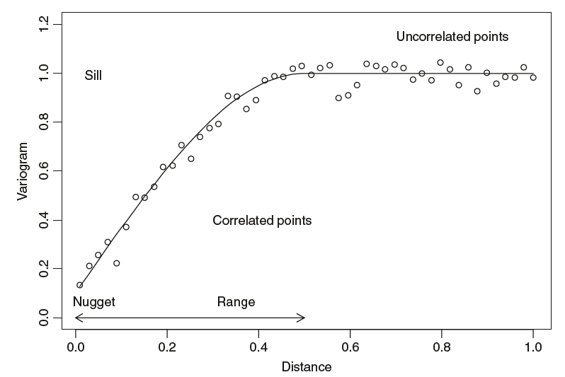
Variogram modelling
Variogram models are derived using the function vgm and defining four main arguments: psil, model, range, and nugget
Psill ➔ the asymptotic value
range ➔ the distance where the sill occurs
vgm(psil = 1,
model = "Sph",
range = 300,
nugget = 0.5)
model psill range
1 Nug 0.5 0
2 Sph 1.0 300
nugget ➔ the y-value when the distance is 0.
Notes:
rm(list=ls());gc()
require(sp)
require(gstat)
vgm(psil = 1,
model = "Sph",
range = 300,
nugget = 0.5)

Slide 53
Variogram modelling
Once you have defined a variogram model and its “initial” attributes, it can be fitted to a sample variogram to define the parametric variogram model for the data at hand.
v <- variogram(log(zinc) ~ 1, meuse)
v.fit <-fit.variogram(v,
vgm(1, "Sph", 800, 1))
v.fit
model psill range
1 Nug 0.05065923 0.0000
2 Sph 0.59060463 896.9976
plot(v,v.fit)
Note that the variogram attributes that fit.variogram generates are different from the original ones.
Notes:
rm(list=ls());gc()
require(sp)
require(gstat)
data(meuse)
coordinates(meuse) <- ~x + y
v <- variogram(log(zinc) ~ 1, meuse)
v.fit <-fit.variogram(v,
vgm(1, "Sph", 800, 1))
v.fit
plot(v,v.fit,## add the number of point pairs for this estimate
plot.numbers = TRUE)

Slide 54
Anisotropy
Isotropy
Anisotropy
The vgm function default assumption is isotropy
However the variability can change with direction
This anisotropy
The sill is reached more rapidly in one direction.
The sill is reach at the same time in all directions

Slide 55
Anisotropy
Variogram map
Based on this map is clear that the variance is not isotropic
Max variance is reaches in one but not another direction
Major range
The two factors needed to model the anisotropy are:
Angle for the principal direction
Ratio of the minor range to the major range
Minor
range
plot(variogram(log(zinc) ~ 1,
data = meuse,
map = TRUE, ## plot the variance between points as a function of the distance in the x and y direction
cutoff = 1000, width = 50))
Notes:
m(list=ls());gc()
require(sp)
require(gstat)
data(meuse)
coordinates(meuse) <- ~x + y
plot(variogram(log(zinc) ~ 1,
data = meuse,
## plot the variance between points as a function of the distance in the x and y direction
map = TRUE,
cutoff = 1000, width = 50))

Slide 56
Anisotropy
v.dir <- variogram(log(zinc) ~ 1, data=meuse,
cutoff = 1000, width = 50)
v.anis <- vgm(0.6, "Sph", 1600, 0.05,
# this argument define the "anisotropy" in the variogram
anis = c( 45 , 0.5 ))
plot(v.dir, v.anis)
Variogram map
main axis direction = 45º
Major range
Minor
range
anisotropy ratio = 0.5
Minor Range/ Major range
Notes:
rm(list=ls());gc()
require(sp)
require(gstat)
data(meuse)
coordinates(meuse) <- ~x + y
plot(variogram(log(zinc) ~ 1,
data = meuse,
## plot the variance between points as a function of the distance in the x and y direction
map = TRUE,
cutoff = 1000, width = 50))
v.dir <- variogram(log(zinc) ~ 1, data=meuse,
cutoff = 1000, width = 50)
v.anis <- vgm(0.6, "Sph", 1600, 0.05,
# this argument define the "anisotropy" in the variogram
anis = c(45, 0.5))
plot(v.dir, v.anis,plot.numbers = TRUE)

Slide 57
So far so good?
Any questions?
Ready to move on?

Slide 58
Some last points on Kriging
Non-linear Transforms of the Response Variable
You can transform your response and build a model with it.
But…
When the “response” is transformed... the inverse transformation of your kriging predictions is not the expected value of the Original Variable.
The same applies to Non-Normal responses (Pres/Abs, Probabilities, counts).

Slide 59
Some last points on Kriging
Kriging cannot deal with Singular Matrix Errors – This means a perfect correlation between observations, which are NOT allowed:
These perfect correlations occur when:
Observations share the same location:
How to find such duplicates – use the zerodist function on a SpatialPoint(DataFrame) object → Only keep one!
Variogram models that result in perfect correlations
vgm(0, "Nug", 0) or vgm(1, "Gau", 1e20)
Models with perfectly correlated variables.
A typical cases are a constant predictors or inverse predictors

Slide 60
So far so good?
Any questions?
Ready to move on?

Slide 61
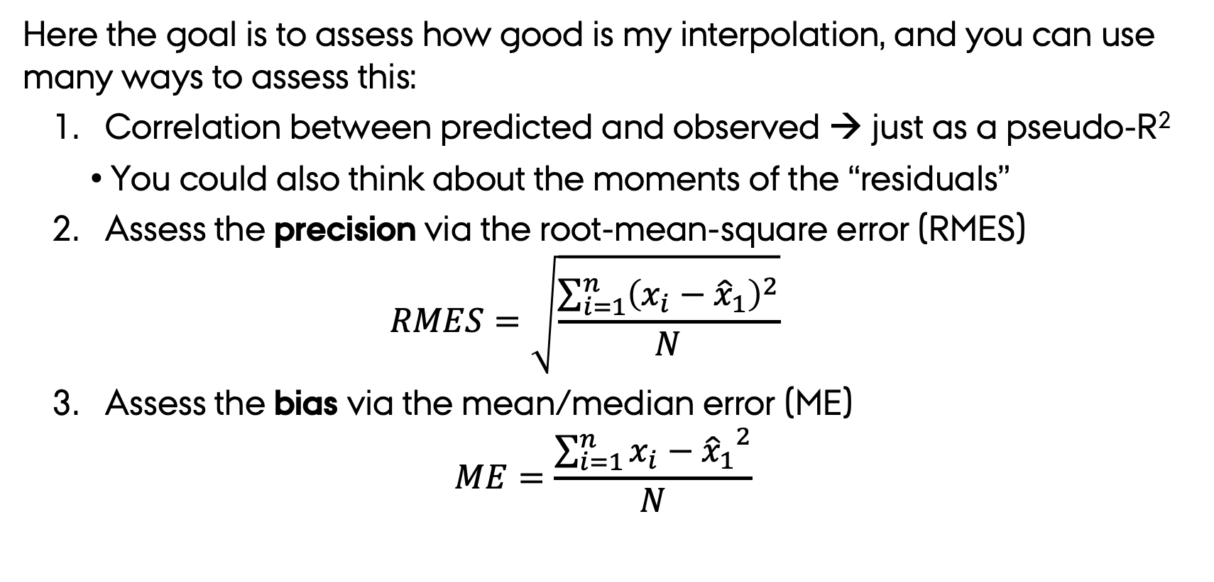
Model Diagnostics - Basic
Here the goal is to assess how good is my interpolation, and you can use many ways to assess this:
Correlation between predicted and observed → just as a pseudo-R²
You could also think about the moments of the “residuals”
Assess the precision via the root-mean-square error (RMES)
$$RMES=\sqrt{\frac{\sum_{i=1}^{n}{{\left(x_{i}−{\hat{x}}_{1}\right)}^{2}}}{N}}$$
Assess the bias via the mean/median error (ME)
$$ME=\frac{\sum_{i=1}^{n}{{x_{i}−{\hat{x}}_{1}}^{2}}}{N}$$

Slide 62
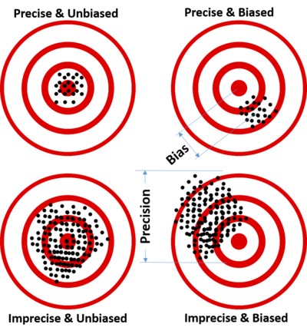
Precision and bias
BIAS: expected value of the results differs from the true underlying quantitative parameter being estimated.
PRECISION: variability of model prediction for a given data point or a value which tells us the spread of our data

Slide 63
ZnVar <- fit.variogram(variogram(log(zinc) ~ 1, meuse),
vgm(1, "Sph", 800, 1))
meuse.krige <- krige(log(zinc) ~ 1,
locations = meuse,
newdata = meuse,
model = ZnVar)
[using ordinary kriging]
# compute and summarize prediction errors
diff <- meuse.krige$var1.pred - log(meuse$zinc)
summary(diff)
Min. 1st Qu. Median Mean 3rd Qu. Max.
-2.665e-15 0.000e+00 0.000e+00 -4.584e-17 0.000e+00 1.776e-15
# RMS error (precision)
sqrt(sum(diff^2)/length(diff))
[1] 6.460131e-16
# mean error (bias)
mean(diff)
[1] -4.584147e-17
sum(diff)/length(diff)
[1] -4.584147e-17
# median error (bias)
median(diff)
[1] 0
High precision
No bias
Notes:
# Ordinary Kriging
rm(list=ls());gc()
require(gstat)
require(sp)
data(meuse)
coordinates(meuse) <- ~ x + y
## Using Kige
meuse.krige <- krige(log(zinc) ~ 1,
locations = meuse,
newdata = meuse,
model = fit.variogram(variogram(log(zinc) ~ 1, meuse),
vgm(1, "Sph", 800, 1)))
# compute and summarize prediction errors
diff <- meuse.krige$var1.pred - log(meuse$zinc)
summary(diff)
# RMS error (precision)
sqrt(sum(diff^2)/length(diff))
# mean error (bias)
mean(diff)
sum(diff)/length(diff)
# median error (bias)
median(diff)
## Using gstat objects
(g2 <- gstat(NULL, id = "zinc", form = log(zinc) ~ 1 , data = meuse,model= v.fit))
meuse.krige <- predict(g2,newdata = meuse)
diff <- meuse.krige$zinc.pred - log(meuse$zinc)
diff <- as.data.frame(diff)
coordinates(diff) <- coordinates(meuse)
bubble(diff, zcol="diff", pch=1,
main="CK evaluation errors log(Zn)")

Slide 64
Model Diagnostics Cross-Validation
Cross-validation provide a way to assess how well the model predicts the values at unknown locations.
The logic behind Cross-validation is simple:
Remove one or more data locations to define a training data set used to build a model
Use the created model to predict the data at the rest of the locations (test data).

Slide 65
Cross-Validation strategies
There are two ways to think about cross-validation:
Leave one out strategy: One one location is removed at a time:
The training dataset used to build this model has N-1 observations.
The procedure can be done with all or a given percentage of the observations.
Test/train strategy: A percent of the observations are set apart to build the model (training dataset), and the fit using the remaining information (test dataset)
The accuracy is then assess using either bias or precision metrics on the “testing” dataset/observation

Slide 66
Cross-Validation strategies in R
The gstat package has two functions to automate the cross-validation process:
krige.cv function which is used for kriging; and implemented just as the krige function [that is formula, locations, data, newdata, model need to be defined]
gstat.cv function which is used for cokriging; and implemented just by passing the gstat object with the linear model of co-regionalisation
In both functions an extra argument (nfold) should be passed, to define the training/test dataset sizes.
If nfold is not specified, the dataset number of rows it assumes a leave one strategy.

Slide 67
Cross-Validation strategies in R
Znc.Var <- fit.variogram(variogram(log(zinc)~1, meuse),
vgm(1, "Sph", 800, 1)
meuse.krige.cv <- krige.cv(log(zinc) ~ 1,
locations = meuse,
model = Znc.Var ),
# this setup results in a leave one out Cross validation
nfold=nrow(meuse))
# RMS error (precision)
res <- as.data.frame(meuse.krige.cv)$residual
sqrt(mean(res^2))
[1] 0.3918015
# mean error (bias)
mean(res)
[1] -2.056426e-05
# median error (bias)
median(res)
[1] -0.01301645
Precision is good overall
slight negative bias
Notes:
rm(list=ls());gc()
require(gstat)
require(sp)
data(meuse)
coordinates(meuse) <- ~ x + y
## Using Kige
meuse.krige.cv <- krige.cv(log(zinc) ~ 1,
locations = meuse,
model = fit.variogram(variogram(log(zinc) ~ 1, meuse),
vgm(1, "Sph", 800, 1)),
# this setup results ina leave one out Cross validation
nfold=nrow(meuse))
summary(meuse.krige.cv)
# RMS error (precision)
res <- as.data.frame(meuse.krige.cv)$residual
sqrt(mean(res^2))
[1] 0.3918015
# mean error (bias)
mean(res)
[1] -2.056426e-05
# median error (bias)
median(res)
[1] -0.01301645
res.cv <- as.data.frame(res)
coordinates(res.cv) <- coordinates(meuse)
bubble(res.cv, zcol="res", pch=19,
main="Cross validation errors")

Slide 68
So far so good?
Any questions?
Ready to finish?

Slide 69
In Summary…
Spatial interpolation is the process of using points with known values to estimate values at other unknown points.
Determining the values in these unknown points can be done:
Using Non-geostatistical Interpolation methods such:
Inverse distance weighting or Bilinear/Cubic interpolation: (Based on distances)
Linear regressions or splines: Using locations and/or widely sampled variables
Using Geostatistical Interpolation methods such:
Kriging: Univariate approach
Co-kriging: Multivariate approach
The semi variogram defines the spatial model that makes these methods Geostatistical

